Slide 1
Ganika
Too Unusual for a Naika?

Slide 2
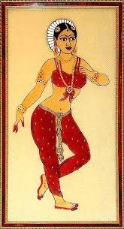

Slide 3
The status of the GanikAs in ancient India
One may note at the very beginning that a ganika is not a common prostitute. They are better understood as courtesans. According to Y. B. Singh, “The Courtesans (ganikā-s) were not like the ordinary prostitutes. They cannot be associated with the flesh trade alone. Their status appears to be similar to those of the hetaerae of Greece.” (Singh, 181)

Slide 4
Hetaera
The hetaera or hetaira (pronounced “hee-tee-a-ra”) were apparently distinguished in ancient Greece from the pornai. The pornai were common prostitutes who served a large number of clients indiscriminately. Etymologically, the word pornai comes from pernemi (to sell). The hetaira, on the other hand, served only a chosen few. They provided companionship and intellectual stimulation besides carnal pleasure.

Slide 5
Ganika versus Vesya
In India, the ganikā-s performed a similar function. They are needed to be distinguished from the veśyā-s. In the Amarakosha, the ancient Indian thesaurus in Sanskrit, veśyā and ganikā are used interchangeably. But other works, like the commentaries of Medhātithi, make distinction between them. A ganikā is considered to be superior to a veśyā.

Slide 6
In order to understand why the Ganikās were superior to common prostitutes, one must turn to an all time classic:
Mallanaga Vatsyayana’s

Slide 7
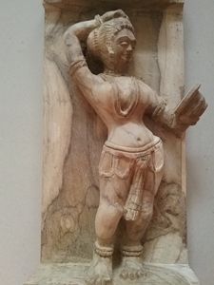
Kama Sutra
(ca. 200 CE – 400 CE)

Slide 8
The Sixty Four Arts
Vatsyayana mentions that a woman should study the sixty four arts along with the kama Shastra. He adds:
“A public woman, endowed with a good disposition, beauty and other winning qualities, and also versed in the above arts, obtains the name of a Ganika, or public woman of high quality, and receives a seat of honour in an assemblage of men. She is, moreover, always respected by the king, and praised by learned men, and her favour being sought for by all, she becomes an object of universal regard.” (Chapter III; translated by Sir Richard Burton)

Slide 9
A Ganika was thus a highly Accomplished courtesan. She moreover commanded a certain respect in Ancient Indian society.

Slide 10
Social Status of the Ganikas
The ganikā –s enjoyed a privileged status in society. Jivaka, the famous physician, was the son of a ganikā named Sālavati (the rival of Āmbapāli). (Singh,184) He is often referred to in ancient texts as Ganikaputra (the son of a ganikā ). The stigma attached to his birth did not jeopardize his career and reputation in anyway. The sons of ganikā –s were thus not always discriminated against. Y. B. Singh informs that in the Gupta period the ganikā –s were even allowed to display their own dhvaja (flag). They could choose whom to consort with, and charged very high fees, as much as 500 gold coins, for their service.

Slide 11
Social Status of the Ganikas
Aditi Singh, however, feels that the general attitude towards the ganika-s was ambivalent. While they were sought after as talented individuals, they were also condemned for their profession. Notably, in Mrcchakatika, Vasantasenā marries Cārudatta in the end. Singh reflects, “The virtuous woman, of true character could not have been left as the courtesan in the play and had to be transformed as the lawful wife, for virtuousness was not the forte of the courtesan but of the wife.” (Singh, 104)

Slide 12
The Origin of the ganikas
Historians believe that the ganikā culture developed out of Indo-Greek contact. The Vedic texts do not speak about the ganikā –s. The first text to mention organized prostitution in ancient India is Kautilya’s Arthaśāstra (ca. 2nd century BCE). But this work does not refer to the exalted status of the ganikā-s. The earliest work where a ganikā is assigned a high status is Mahāvagga (uncertain date) which tells the tale of the famous ganikā Āmbapāli who worshipped Buddha.

Slide 13
The Origin of the Ganikas
It appears that the ganikā–s received their exalted social status in the golden age of the imperial Guptas (ca. 240 – 50 C.E.). Texts like Sudrakas Mrcchakatika, Isvaradatta’s Dhurta-Vita-Samvada, and Ubhayabhisarika of Vararuci describe the ganikā –s. According to Aditi Singh, “The courtesans were significant in the courtly life where their lives are mentioned as being inseparable from the life of the king.” (Singh, 102)

Slide 14
In Nātyaśāstra
Bharata describes four types of heroines:
Celestial ones
Queen
Lady of nobility
Courtesan

Slide 15
In Nātyaśāstra
The courtesans were supposed to have the following characteristics:
Light-heartedness
Exaltedness
Expertise in dance, music and other arts.

Slide 16
Conclusion
Sudraka’s choice of Vasantasenā as his heroine was therefore not at all unconventional. Moreover, Vasantasenā’s accomplishments and refined temper should not appear as a surprise to us. She is gunānuraktā (lover of virtue), as opposed to dhananuraktā (lover of wealth). Vatsyayana too advises the ganikā’s, “those who are possessed of excellent qualities are to be resorted to for the sake of love, and fame.” (Part Vi, Chapter I)

Slide 17
Reading list
Singh, Aditi. “Women’s World: Artistes, Courtesans and Wives in Early India”, Proceedings of the Indian History Congress, vol. 75 (2014): 99 – 106.
Y. B. Singh. “Roots of the Ganika Culture of Early India”, Annals of the Bhandarkar Oriental Research Institute, vol. 74, no. 1/44 (1993): 181 – 190)
Vatsyayana, Mallanaga. Kama Sutra of Vatsyayana, trans. Sir Richard Burton, 1883. http://www.sacred-texts.com/sex/kama/

Slide 18
Prepared By
Dr Ayusman Chakraborty
Assistant Professor
Department of English
Taki Government College

Slide 19
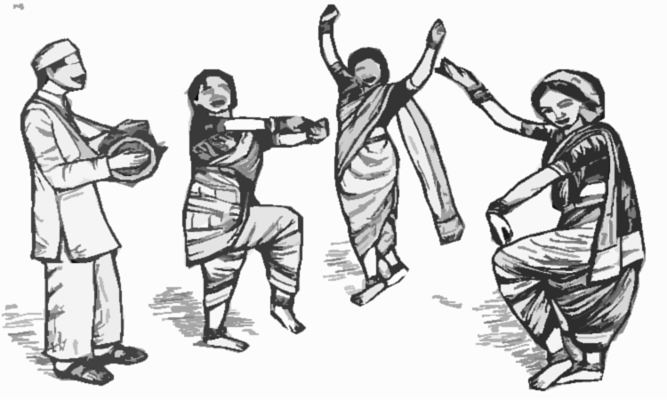
The end

