Slide 1
Shakespeare’s Theatre

Slide 2
The Bard of Avon (1564 – 1616)

Slide 3
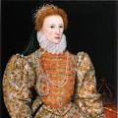
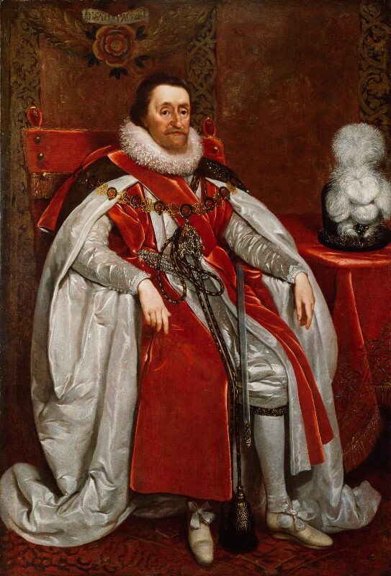
Shakespeare’s Age
Queen Elizabeth I
King James I

Slide 4
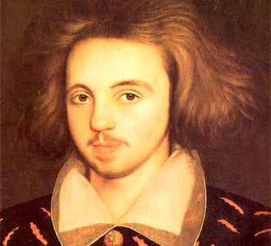
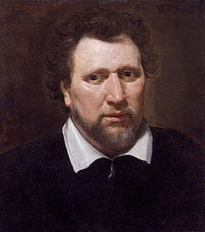
Shakespeare’s Rivals
Christopher Marlowe (Tragedy)
Ben Jonson (Comedy)

Slide 5
Shakespeare’s Company
Lord Chamberlain’s Men
King’s Men, after 1603

Slide 6
Shakespeare’s Playhouses
The Theatre – expired in 1597
The Globe – 1598 – 1613.
The Blackfriars – 1608 – 1655. (private theatre)

Slide 7
The Globe
Built in 1598 by the Lord Chamberlain’s Men on Bankside, using timber from the earlier playhouse The Theatre.
Open air theatre.
Plays were staged in the afternoon, announced by a trumpet call from the roof.
A penny for standing in the yard. Another gave access to the gallery. A few penny more would get one a seat. The best people sat in the Lords’ Room.
During the performance the audience enjoyed food and drink. These theatres had no lavatories.
Destroyed by fire in 1613 during a performance of Shakespeare’s Henry VIII, when a theatrical canon misfired.

Slide 8
Sketch of the Swan Theatre

Slide 9
Shakespeare’s Actors
All male cast
Young Boys played the female roles.
Some famous actors:
Richard Burbage (Hamlet, Othello, Lear etc)
William Kempe (comic actor, Feste, Fool in Lear etc)
John Heminge & Henry Condell (editor of First Folio)

Slide 10
Plays where Shakespeare Collaborated with Others
Sir Thomas More (mainly by Anthony Munday)
Cardenio (with Fletcher, now lost)
The Two Noble Kinsmen (with Fletcher)
Henry VIII or All is True (with Fletcher)

Slide 11
Reading List
Frank Kermode. The Age of Shakespeare. London: Phoenix, 2005.
Alfred Harbage. Shakespeare’s Audience. New York: Columbia University Press, 1941.

Slide 12
Presented By
Dr Ayusman Chakraborty
Assistant professor
Department of English
Taki Government College

Slide 13
The End

